Slide 1



5 Ways to Bake your Remote Cake
Lawrence Muthoga
Lawrence.muthoga@microsoft.com
github.com/lamuthog

Slide 2

VS Code for Remote Development

Slide 3

Lawrence Muthoga
Microsoft Developer Audience PMM
Lawrence.muthoga@microsoft.com
github.com/lamuthog

Slide 4
Motivation
Development, Test Increasingly Remote
Facebook: Mono repo, team members use huge VM as a remote dev box
Data Scientists: Leverage specialized VMs (e.g. GPU heavy servers)
Cloud Based Tools: codesandbox.io, coder.com, gitpod, stackblitz
Poor Remote Development Experiences
VMs: terminal + vim or file syncing
Tools: Need to replicate context locally
Remote Desktop: Typing, mouse lag, hard to set up on Linux
Browser only tooling solutions
Setting up development environments is tedious
Windows Subsystem for Linux

Slide 5
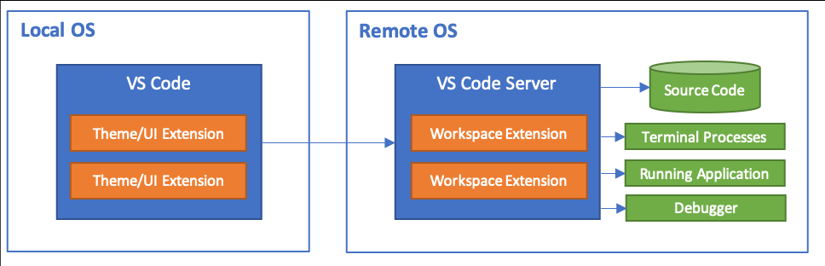
Solution
Develop in the context of the remote machine or container
Client Tools Connected to Remote Services

Slide 6
Remote Development Extensions
Remote Extensions
Remote – WSL
Remote – SSH
Remote – Containers
Remote Development Pack
Extension Management
Local and Remote
Remote Settings

Slide 7


Codespaces and Liveshare
Realtime Collaboration
Shared Code
Shared Terminal
Even across Github Codespaces

Slide 8

Windows Subsystem for Linux (WSL)
What is WSL? Run full Linux distros on Windows
“Linux first” command line tools like bash, sed, awk, etc.
Fully isolated development environments
Support for multiple distros
VS Code UI runs on Windows, extensions run in WSL
Supported: Ubuntu, Debian, openSUSE
Preview: Alpine, ARM64
glibc vs. musl libc implementation
Not all extensions run on ARM or Alpine (e.g. C++)

Slide 9

SSH
Why: Platform requirements, battery life, performance, security
Supported: Running SSH server on
x86_64 Debian 8+, Ubuntu 16.04+, CentOS / RHEL 7+
ARMv7l (AArch32) Raspbian Stretch/9+ (32-bit)
ARMv8l (AArch64) Ubuntu 18.04+ (64-bit)
Preview: Windows 10/Server 2016/2019 (1803+)
VS Code Insiders
Official OpenSSH Server
Alpine not yet available

Slide 10

Containers
Sandbox your development environment
Avoid accidentally impacting local machine config
Better manage multiple versions of same runtime
Access tools, runtimes not available for your local OS
Reduce risk of a security issue affecting your local OS
A Development Container is…
A running Docker container with a tool and framework stack
Runtimes such as Python, Node, Go, Java etc.
Tools such as pylint
Local source folder mounted into the container, git credentials mapped in
Configured with a devcontainer.json file
Windows containers not yet supported

Slide 11
Scenarios
Attach to a running container
Config file to automate setting up tools in running container
Develop in a stand-alone sandbox
Try a Sample!

Slide 12
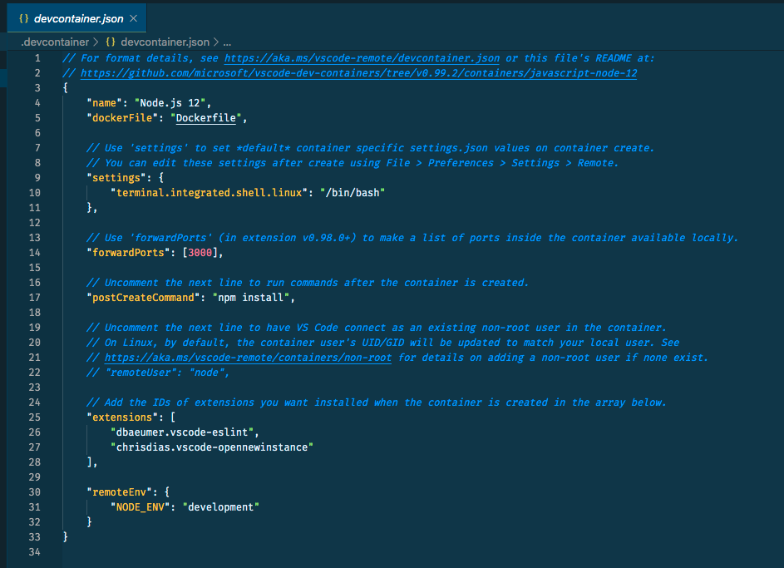
devcontainer.json
Configure how VS Code builds and runs containers
Scenarios
Set up port forwarding
Create and run as alternate (to root) users
Set up environment variables inside container
Set up VS Code settings
Define which extensions to install
Run additional commands inside container after it starts
Much much more (see Advanced container configuration)
Enhances dockerfile, docker_compose

Slide 13
Advanced Container Scenarios
Git: Use existing Git credentials (SSH or in credential manager) from the container (Most interesting for Windows when using SSH keys) Link
Multi Service: Work in multiple containers in the same app at same time, with separate devcontainer.json configurations (e.g. One is Node.js, one is Python) Link
Performance: Store files that require a high disk I/O in a “named volume” to improve performance on Windows and macOS (no benefit on Linux) Link
Deploy: Deploy to a set of Docker (or K8S) containers from inside a development container. Sandbox your tools, then deploy for testing using your normal workflow Link
Remote Docker: Develop inside a container on a remote Docker host Link

Slide 14
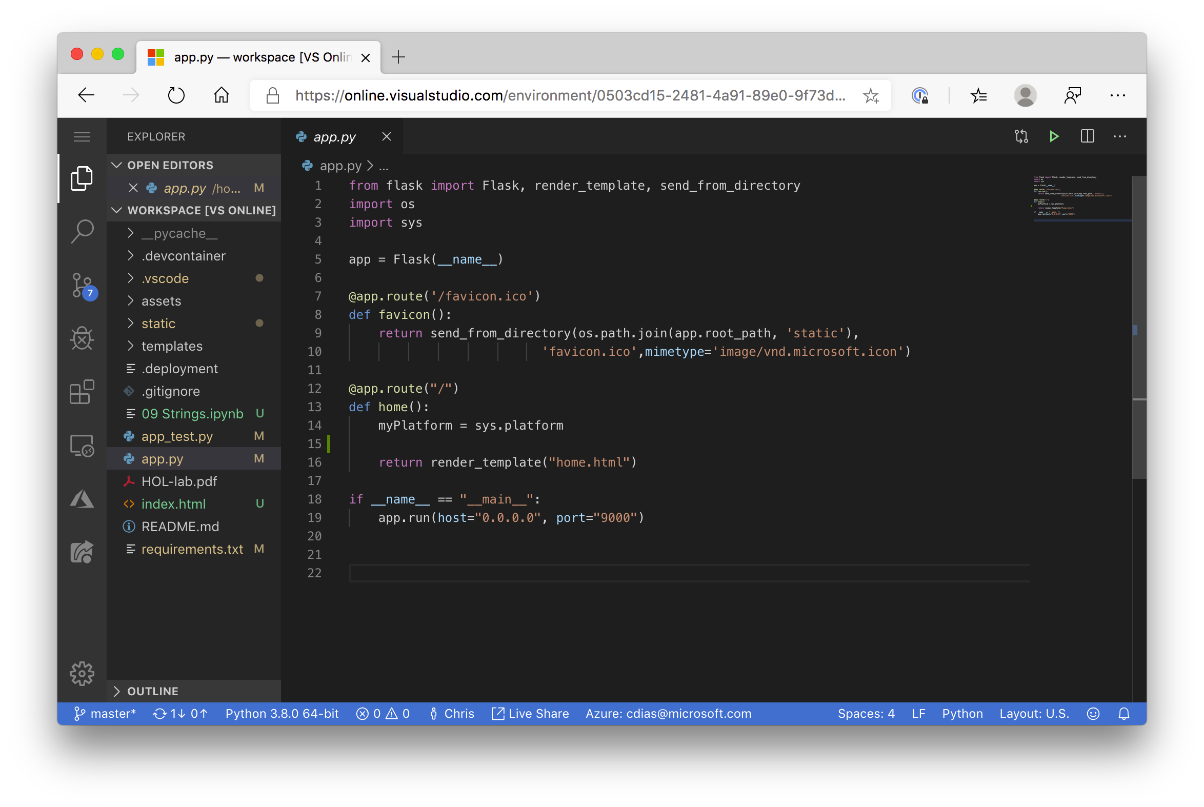
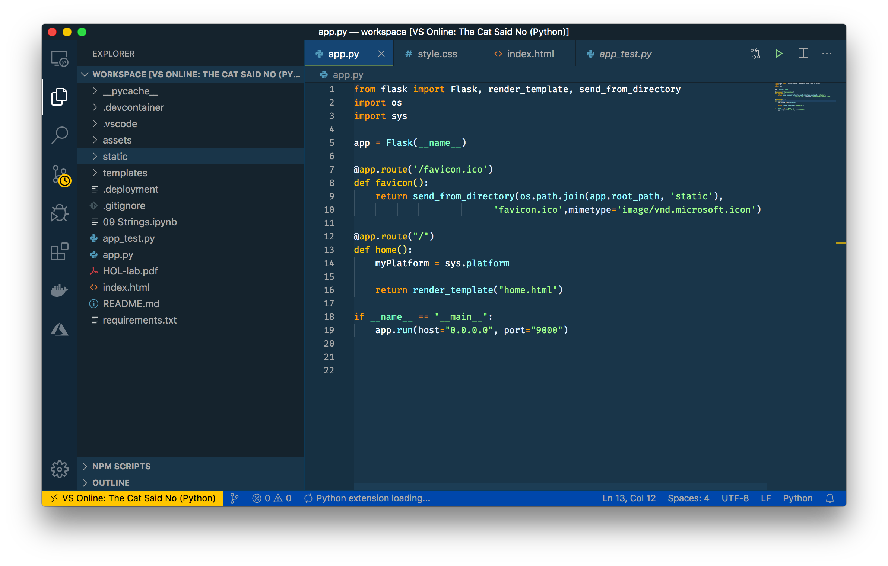
Visual Studio Online
Built on Remote infrastructure
Microsoft managed remote workspaces
Open remote workspace from desktop
VS Code hosted in browser

Slide 15
Useful Links
More Tips | https://code.visualstudio.com/tips
Debugging | https://github.com/microsoft/vscode-recipes
Remote | https://code.visualstudio.com/docs/remote
WSL | https://docs.microsoft.com/en-us/windows/wsl/about
Insiders | https://code.visualstudio.com/insiders/
Docker | https://www.docker.com
Marketplace | https://marketplace.visualstudio.com/vscode

Slide 16
https://aka.ms/GHAvscode

Slide 17
Thank you!
Lawrence Muthoga
Lawrence.muthoga@microsoft.com
github.com/lamuthog

